Slide 1
IAPT Services and Community Mental Health Transformation During and Post COVID
IMHCN Webinar 21st January 2021
Presented By
Pól Toner
Managing Director
Essex Learning Disability Partnership & Trust-wide IAPT
Trust wide Lead for Transformation

Slide 2
Transforming IAPT and Community Mental Health Services
Prior to the COVID Pandemic HPFT had developed a comprehensive Programme of Transformation across all service lines within the Trust, adopting a Continuous Quality Improvement (CQI) approach to transforming and delivering Mental Health Services .
During the initial out break in Spring 2020 it was necessary to pause some of these transformation plans in order to allow for staff redeployment to priority services.
Following the end of the National Lockdown in the Summer of 2020 all service lines and transformation projects within the trust entered a recovery stage.
All Transformation Projects that were identified as being key to manage system wide demand and capacity during the continuing pandemic and in readiness for the winter months were refreshed to increase the offer of services to include treatments and interventions required as a result of the pandemic including but not limited to;
Increased services and greater partner working to engage with those experiencing Depression and Anxiety and the Mental Health difficulties as a result of the COVID Pandemic
To give a Psychological and Physical MDT approach for those suffering respiratory disease as a result of COVID infection
To give Psychological and Physical MDT approach for those suffering from Long COVID Symptoms
To give support to emergency workers dealing with members of the public who may be in crisis
To give support to families and carers who may for the first time find themselves caring for a loved one as a result of COVID infection who previously were in good health
Increased virtual and teleconsultations to ensure continued delivery of services in a COVID safe environment

Slide 3
Transforming IAPT and Community Mental Health Services as a result of the COVID Pandemic
As a result of the Pandemic HPFT has moved swiftly to increase the service offer of both IAPT and Community Mental Health Services over to treatments and interventions affected by COVID. Additionally we have looked to develop services and support to the healthcare system at a system and regional level.
In the following slides we will look at the refocused high level vision and aims of the Transformation Programme for those projects that will be reshaped.
All the initiatives and interventions we have already or are in the process of implementing will now be added to earlier transformation plans. By using evidenced based care we will further strengthen these interventions by developing and embedding Evidence Based Care pathways across our service lines to reflect the changing landscape in Mental Health Care, Treatments and Interventions as a result of COVID. As we understand more of an impact on Mental and Physical health and as more research in the long term effects of COVID becomes available.

Slide 4
Vision & Aims – Increasing Our Service Offer as a Result of the COVID Pandemic IAPT & Community Mental Health Services
To provide recovery focussed services via additional COVID led interventions and pathways to enable people to maximise their mental and physical wellbeing during and after the COVID Pandemic
Ensuring we meet the needs of all service users including those with complex mental health difficulties and those suffering with increased depression, anxiety and/or substance misuse as a direct result of the Pandemic.
Ensuring that those suffering with long-term COVID or respiratory difficulties as a result of infection are offered a Psychological and Physical package of healthcare to enhance their recovery.
To relieve pressure on the healthcare system, allowing Secondary Care providers to focus on manging increased demand as a result of patients requiring hospitalisation and specialist physical health care as a resulting from infection.
To work closely with Secondary and Primary care providers to offer both Psychological and Physical healthcare package for those affect by COVID.

Slide 5
Community Mental Health Services First Response
Streamlined access via the free-phone SPA number, and additional pathway through NHS111 option 2, as part of the 24/7 MH Advice and Support Line
24/7 access to mental health telephone triage and assessment for anyone when in crisis
Introduced new band 5 Tele coach positions, to support gap between B4 Support Workers (initial conversation; taking detail and initial triage) and Band 6 Crisis Clinicians – freeing crisis workers to manage complex presentations
Crisis plan agreed between First Response and the caller within 1 hour, with clarity on next steps
Pathways into and out of other service lines of HPFT have been agreed
Pathways into and out of Herts Mind Network Crisis Cafés and other services agreed in partnership

Slide 6
Community Mental Health Services Crisis Resolution and Home Treatment (CRHT)
Provide assessment, crisis intervention, recovery, therapeutic intervention and treatment
Addition of Occupational Therapists, Psychologist, Psychology Assistants to enhance the existing team of Nurses, Social workers, Doctors and Support Workers.
Extended from average 4 week to 12 week pathway to include therapeutic interventions and resilience building to avoid future crisis
Input is provided where it is needed by the person - building base, community resource, home etc.
Therapeutic approach individually and as a team
Focus on relapse prevention to avoid people repeatedly using the same services in the same way
Increased coping strategies
Virtual group-work has commenced; working on Covid secure delivery
Joined up therapy across in-patients/Crisis/community
Closer working with over 65’s service, including Crisis Function Teams
Pathways linking HPFT service lines (PD service, Older Adults, CYP etc.) and 3rd sector agencies
Partnership working with MIND crisis café

Slide 7
IAPT and Community Mental Health Services - COVID Specific Initiatives and Interventions All Age Crisis Provision
Pilot of CATT taking on people with functional illness over 65
Training (Safe prescribing in older people, Functional illnesses in Older adults highlighting differences from adults of working age, Delirium and Frailty)
2 x B5 mental health OTs in post
One B6 nurse recruited with older peoples experience. (one B6 out to advert)
Since the beginning of January 2020, services have been expanded to ensure they provide access for people over 65.
24/7 Mental Health crisis telephone triage and assessment
Face to face assessments as appropriate out of hours.
MIND (Nightlight/Crisis Cafes/Crisis support line) are open to all ages.
Partnership working between MIND and HPFT
The Crisis Function OT’s and the CATT OTs are linking up to provide all age sessions in the community.
Group work is re-starting at the Diversion hub building bases including bookable ‘drop in’ sessions for people to access CGL and the Homeless services, which are accessible to people over 65 who are under Crisis Function.

Slide 8
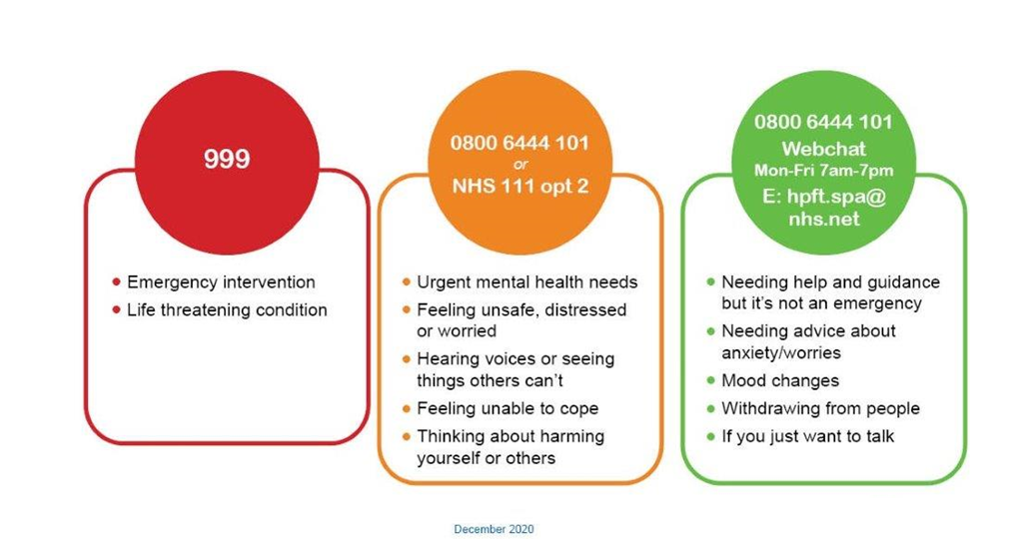
Crisis Resolution and Home Treatment Team (CRHT) – Crisis traffic lights

Slide 9
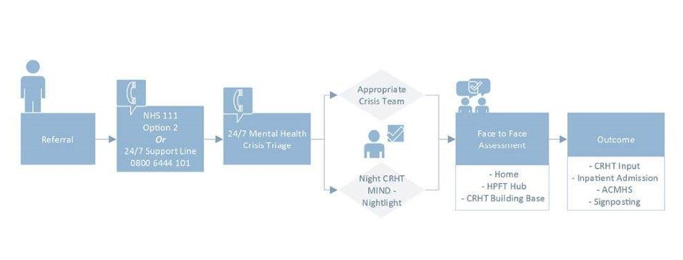
Mental Health Pathway

Slide 10
IAPT and Community Mental Health Services COVID Specific Initiatives and Interventions
A Psychological Therapies MDT approach for treating and Supporting suffers of long COVID
which will support colleagues across the system to ensuing a Psychological Therapies approach when caring for sufferers of Long COVID to give both physical and mental health care package.
HPFT are currently engaged in a Joint bid to fund a Staff Wellbeing Service for staff working on the front line that have been affected by COVID on a professional or a personal level.
The service will offer a number of interventions and methods of support and staff will have quick access to services.
HPFT are working across the region to develop as a consistent and unified approach as possible to supporting who as a result the pandemic are now suffering with increased levels of anxiety, depression and feelings of isolation.
https://www.northessexiapt.nhs.uk/webinars
https://www.northessexiapt.nhs.uk/hertfordshire
https://www.northessexiapt.nhs.uk
https://www.youtube.com/channel/UCvHr8P_7rfINqh_MxjwoEhQ/
https://www.northessexiapt.nhs.uk/webinars

Slide 11
IAPT and Community Mental Health Services COVID Specific initiatives and Interventions Cont’d
Assessing and engaging with long COVID sufferers to offer both High and Low intensity support with a MDT approach as quickly as possible to reduce the anxiety and longer term effects on mental and physical health
We are currently working on a regional project to launch pathway for needle phobia, where their phobia is so intense that this is a barrier to receiving the COVID vaccine. As part of this work we are also looking at ways of supporting our LD service users who may find attending large Vaccination Centres extremely difficult.
HPFT have developed a series of IAPT Webinars and you tube videos which help look at ways to manage anxiety and depression during the pandemic

Slide 12
IAPT and Community Mental Health Services COVID Specific initiatives and Interventions Cont’d
HPFT are working with Respiratory Teams in the region to help people deal with anxiety associated with breathing difficulties.
Looking at were we can be more responsive to requests across the system for psychological support for service users who may still be hospitalised or who are suffering from the longer term effects of infection, and the mental health issues rising from lockdowns and isolation.
HPFT are developing Direct pathways into specialist services in acute settings and increasing co-location of services within the acute setting.

Slide 13
IAPT and Community Mental Health Services COVID Specific initiatives and Interventions Cont’d
We are looking to further develop the support we offer Carers specifically those caring for people suffering with long-term COVID, where they may not have had to care for a loved one before.
Extended 24/7 Help support line and enhanced the service by offering a direct route to the Single Point of Access for the 111 service to alleviate pressures and reduce attendances to A&E.
Community services have re focused resources to ensure the most clinically vulnerable patients continue to have face to face appointments in a COVID safe environment.
A clear Emphasis on enhanced primary care, social prescribing, peer support and a move away from CPA as we implement the community framework.

Slide 14
IAPT and Community Mental Health Services Proposed Outcomes
For the person
Able to access support from HPFT without accessing the emergency services or other health services
Crisis plan and next steps in one hour from contact with First Response
Assessment in a way and place that works for the person in crisis, including extended assessment in a building base
For carers
Concerns taken seriously and encouraged to be part of care and support planning
For the health economy
Managing people in crisis at an earliest stage of crisis
Reducing repeat attendance at Emergency Departments or GP surgeries
Access to CRHT pathway for e.g. Ambulance Service; Police via Street Triage; other partners

